Slide 1
Evaporation
14.1. INTRODUCTION
Evaporation, a widely used method for the concentration of aqueous solutions, involves the removal of water from a solution by boiling the liquor in a suitable vessel, an evaporator, and withdrawing the vapour. If the solution contains dissolved solids, the resulting strong liquor may become saturated so that crystals are deposited. Liquors which are to be evaporated may be classified as follows:
(a) Those which can be heated to high temperatures without decomposition, and those
that can be heated only to a temperature of about 330 K.
(b) Those which yield solids on concentration, in which case crystal size and shape
may be important, and those which do not.
(c) Those which, at a given pressure, boil at about the same temperature as water, and
those which have a much higher boiling point.

Slide 2
Evaporation is achieved by adding heat to the solution to vaporise the solvent. The heat
is supplied principally to provide the latent heat of vaporisation.
The design of an evaporation unit requires the practical application of data on heat
transfer to boiling liquids, together with a realisation of what happens to the liquid during
concentration. In addition to the three main features outlined above, liquors which have
an inverse solubility curve and which are therefore likely to deposit scale on the heating
surface merit special attention.

Slide 3
14.2. HEAT TRANSFER IN EVAPORATORS
14.2.1. Heat transfer coefficients
The rate equation for heat transfer takes the form:
where:
Q is the heat transferred per unit time,
U is the overall coefficient of heat transfer,
A is the heat transfer surface, and
T is the temperature difference between the two streams.

Slide 4
In applying this equation to evaporators, there may be some difficulty in deciding the
correct value for the temperature difference because of what is known as the boiling point
rise (BPR) which is (At the same pressure, a solution has a boiling point greater than that of water, and the difference between its boiling point and that of water is the BPR).
If water is boiled in an evaporator under a given pressure, then the temperature
of the liquor may be determined from steam tables and the temperature difference is readily
calculated.. For example, at atmospheric pressure (101.3 kN/m2), a 25 per cent solution of sodium chloride boils at 381 K and shows a BPR of 8 deg K. If steam at 389 K were used to concentrate the salt solution, the overall temperature difference would not be (389 − 373) = 16 deg K, but (389 − 381) = 8 deg K. Such solutions usually require more heat to vaporise unit mass of water, so that the reduction in capacity of a unit may be considerable. The value of the
BPR cannot be calculated from physical data of the liquor, though D¨uhring’s rule is often
used to find the change in BPR with pressure. If the boiling point of the solution is plotted
against that of water at the same pressure, then a straight line is obtained, as shown for
sodium chloride in Figure 14.1. Thus, if the pressure is fixed, the boiling point of water
is found from steam tables, and the boiling point of the solution from Figure 14.1. The
boiling point rise is much greater with strong electrolytes, such as salt and caustic soda.

Slide 5
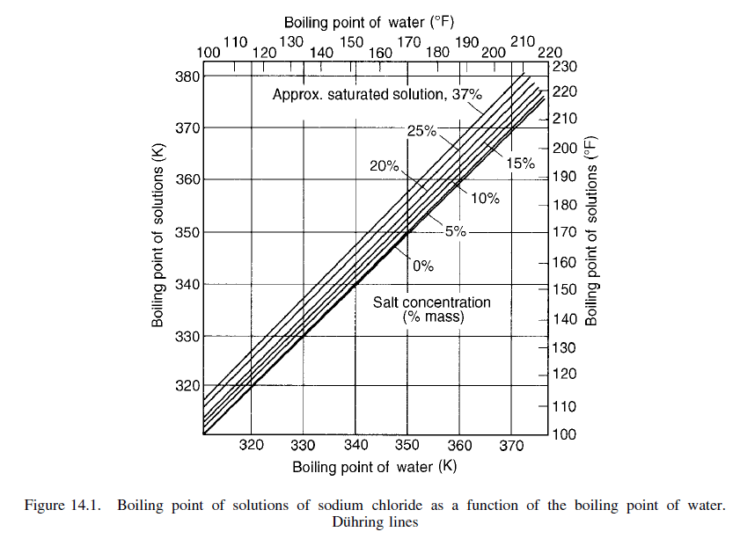

Slide 6
Overall heat transfer coefficients for any form of evaporator depend on the value of the film coefficients on the heating side and for the liquor, together with allowances for scale deposits and the tube wall. For condensing steam, which is a common heating medium, film coefficients are approximately 6 kW/m2 K. There is no entirely satisfactory general method for calculating transfer coefficients for the boiling film. Design equations of sufficient accuracy are available in the literature, however, although this information should be used with caution.

Slide 7
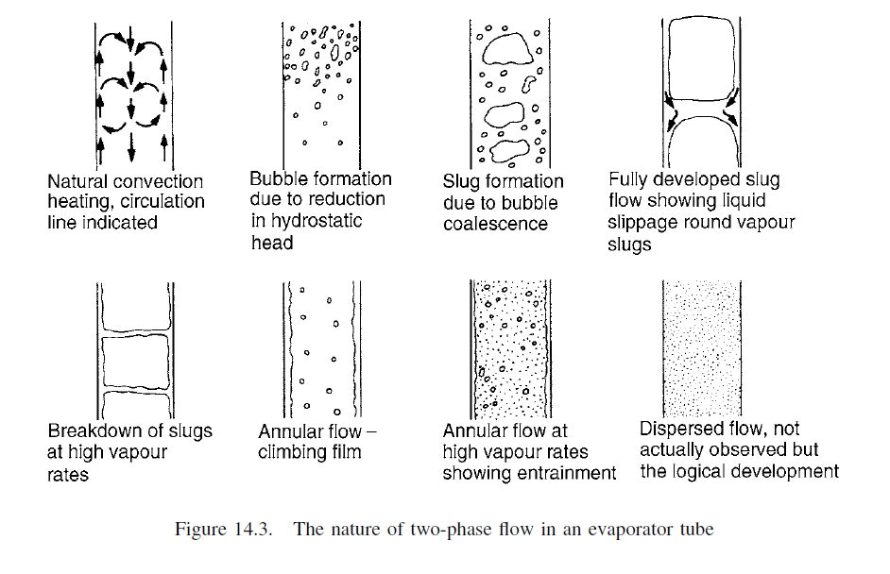
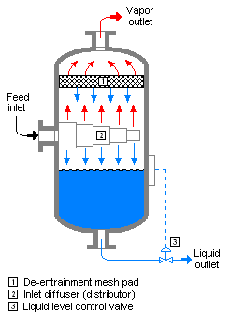
14.3. SINGLE-EFFECT EVAPORATORS

Slide 8
Example 14.1
A single-effect evaporator is used to concentrate 7 kg/s of a solution from 10 to 50 per cent solids.
Steam is available at 205 kN/m2 and evaporation takes place at 13.5 kN/m2. If the overall coefficient
of heat transfer is 3 kW/m2 deg K, estimate the heating surface required and the amount of
steam used if the feed to the evaporator is at 294 K and the condensate leaves the heating space
at 352.7 K. The specific heats of 10 and 50 per cent solutions are 3.76 and 3.14 kJ/kg deg K
respectively.
Solution
Assuming that the steam is dry and saturated at 205 kN/m2, then from the Steam Tables in the
Appendix, the steam temperature = 394 K at which the total enthalpy = 2530 kJ/kg.
At 13.5 kN/m2, water boils at 325 K and, in the absence of data on the boiling point elevation,
this will be taken as the temperature of evaporation, assuming an aqueous solution. The total
enthalpy of steam at 325 K is 2594 kJ/kg.
Thus the feed, containing 10 per cent solids, has to be heated from 294 to 325 K at which
temperature the evaporation takes place.

Slide 9
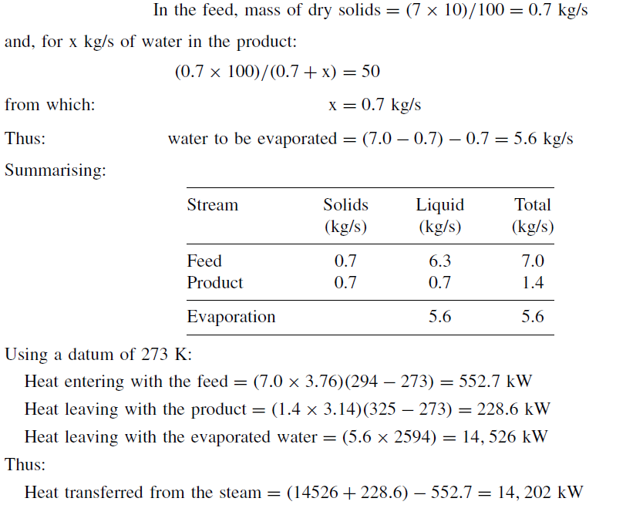

Slide 10
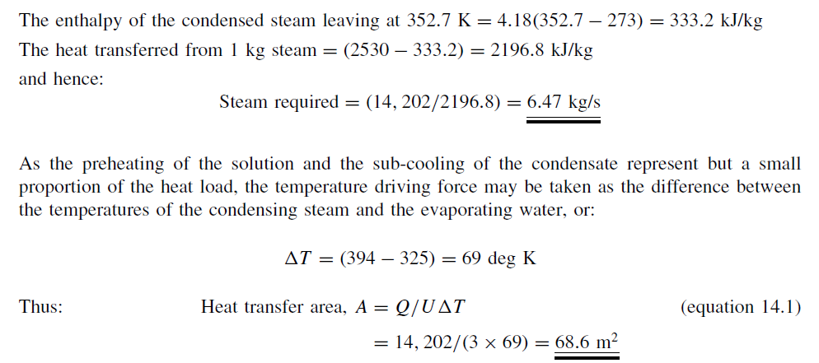

Slide 11
14.4. MULTIPLE-EFFECT EVAPORATORS
The single effect evaporator uses rather more than 1 kg of steam to evaporate 1 kg of
water. Three methods have been introduced which enable the performance to be improved,
either by direct reduction in the steam consumption, or by improved energy efficiency of
the whole unit. These are:
(a) Multiple effect operation
(b) Recompression of the vapour rising from the evaporator
(c) Evaporation at low temperatures using a heat pump cycle.

Slide 12
14.4.1. General principles
If an evaporator, fed with steam at 399 K with a total heat of 2714 kJ/kg, is evaporating
water at 373 K, then each kilogram of water vapour produced will have a total heat content of 2675 kJ. If this heat is allowed to go to waste, by condensing it in a tubular condenser or by direct contact in a jet condenser for example, such a system makes very poor use of steam. The vapour produced is, however, suitable for passing to the calandria of a similar unit, provided the boiling temperature in the second unit is reduced so that an adequate temperature difference is maintained. This, as discussed in Section 14.2.4, can be effected by applying a vacuum to the second effect in order to reduce the boiling point of the liquor. This is the principle reached in the multiple effect systems which were introduced by Rillieux in about 1830. For three evaporators arranged as shown in Figure 14.5, in which the temperatures and pressures are T1, T2, T3, and P1, P2, P3, respectively, in each unit, if the liquor has no boiling point rise, then the heat transmitted per unit time across each effect is:

Slide 13
Neglecting the heat required to heat the feed from Tf to T1, the heat Q1 transferred
across where A1 appears as latent heat in the vapour D1 and is used as steam in the
second effect, and:

Slide 14
On this analysis, the difference in temperature across each effect is inversely proportional
to the heat transfer coefficient. This represents a simplification, however, since:
(a) the heat required to heat the feed from Tf to T1 has been neglected, and
(b) the liquor passing from stages 1 to 2 carries heat into the second effect, and this
is responsible for some evaporation. This is also the case in the third effect.
The latent heat required to evaporate 1 kg of water in 1, is approximately equal to
the heat obtained in condensing 1 kg of steam at T0. Thus 1 kg of steam fed to 1 evaporates 1 kg of water in 1. Again the 1 kg of
steam from 1 evaporates about 1 kg of steam in 2. Thus, in a system of N effects,
1 kg of steam fed to the first effect will evaporate in all about N kg of liquid.

Slide 15
This gives a simplified picture, as discussed later, although it does show that one of the great
attractions of a multiple-effect system is that considerably more evaporation per kilogram
of steam is obtained than in a single-effect unit. The economy of the system, measured
by the kilograms of water vaporised per kilogram of steam condensed, increases with the
number of effects.
The water evaporated in each effect is proportional to Q, since the latent heat is
approximately constant. Thus the total capacity is:

Slide 16
assuming the area of each effect is the same. A single-effect evaporator operating with a temperature difference $\sum{∆T}$, with this average coefficient Uav, would, however, have the same capacity Q = UavA$\sum{∆T}$ . Thus, it is seen that the capacity of a multiple-effect system is the same as that of a single effect, operating with the same total temperature difference and having an area A equal to that of one of the multiple-effect units. The value of the multiple-effect system is that better use is made of steam although, in order to achieve this, a much higher capital outlay is required for the increased number of units and accessories.

Slide 17
14.4.2. The calculation of multiple-effect systems
In the equations considered in Section 14.4.1, various simplifying assumptions have been made which are now considered further in the calculation of a multiple-effect system. In particular, the temperature distribution in such a system and the heat transfer area required in each effect are determined.

Slide 18
Example 14.2A (Forward-feed)
4 kg/s (14.4 tonne/hour) of a liquor containing 10 per cent solids is fed at 294 K to the first effect
of a triple-effect unit. Liquor with 50 per cent solids is to be withdrawn from the third effect, which
is at a pressure of 13 kN/m2 (∼0.13 bar). The liquor may be assumed to have a specific heat of
4.18 kJ/kg K and to have no boiling point rise. Saturated dry steam at 205 kN/m2 is fed to the
heating element of the first effect, and the condensate is removed at the steam temperature in each
effect as shown in Figure 14.5.
If the three units are to have equal areas, estimate the area, the temperature differences and the
steam consumption. Heat transfer coefficients of 3.1, 2.0 and 1.1 kW/m2 K for the first, second,
and third effects respectively, may be assumed.
Solution 1
A precise theoretical solution is neither necessary nor possible, since during the operation of the
evaporator, variations of the liquor levels, for example, will alter the heat transfer coefficients and
hence the temperature distribution. It is necessary to assume values of heat transfer coefficients,
although, as noted previously, these will only be approximate and will be based on practical
experience with similar liquors in similar types of evaporators.
Temperature of dry saturated steam at 205 kN/m2 = 394 K.
At a pressure of 13 kN/m2 (0.13 bar), the boiling point of water is 325 K, so that the total
temperature difference $\sum{∆T}$ = (394 − 325) = 69 deg K.

Slide 19
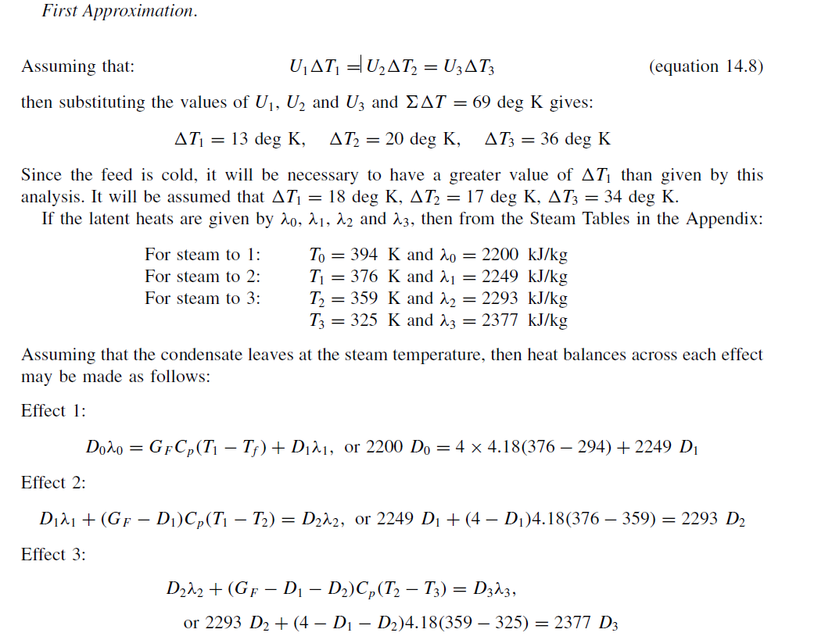

Slide 20
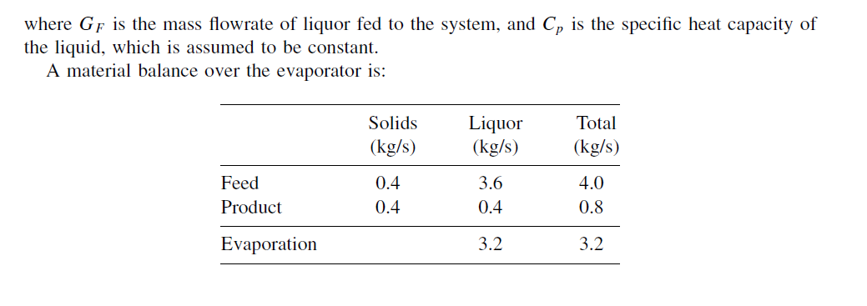

Slide 21
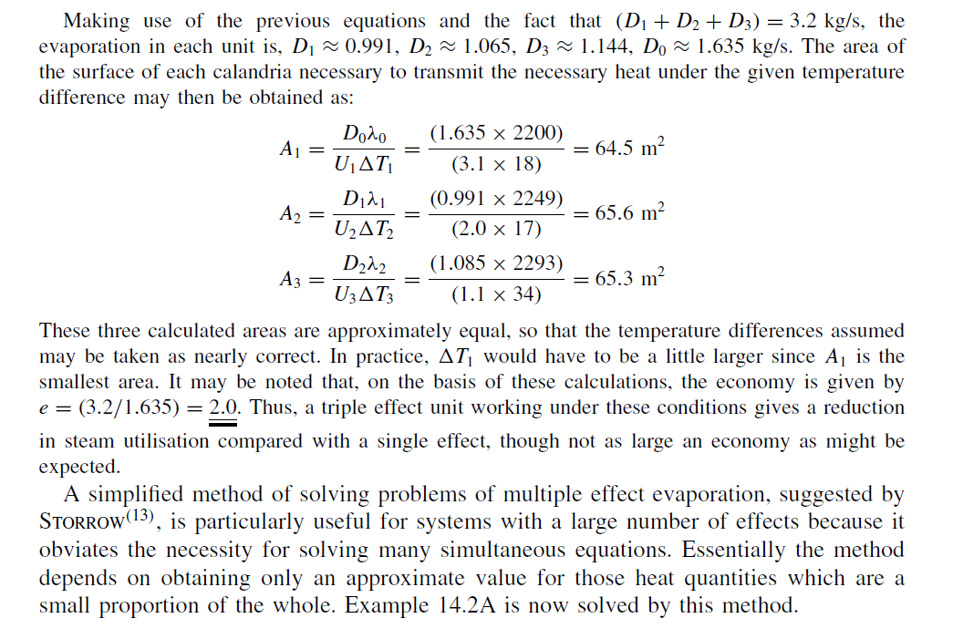

Slide 22
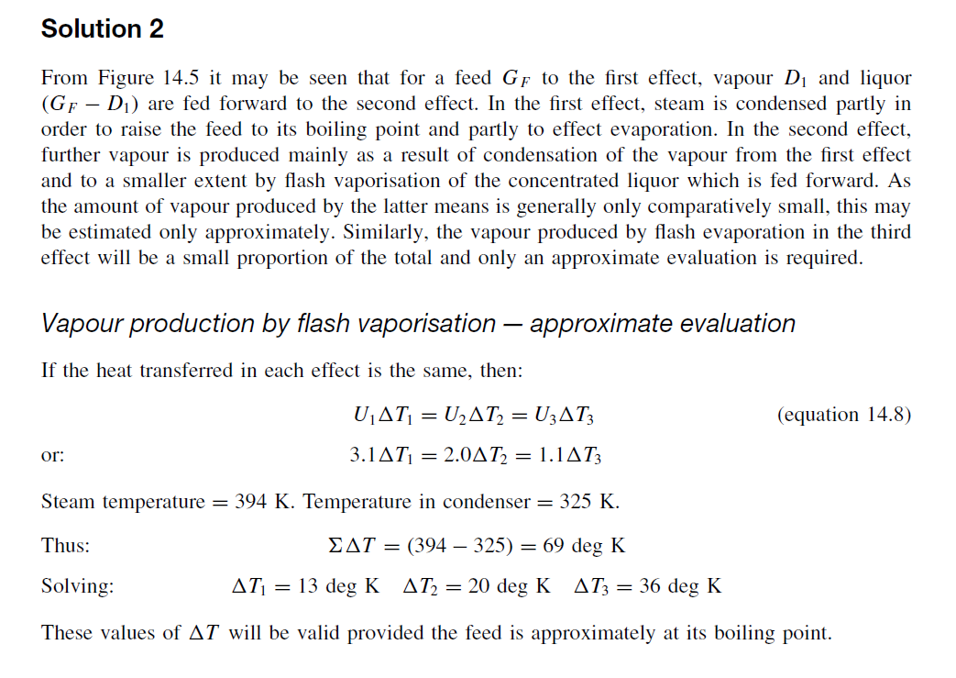

Slide 23
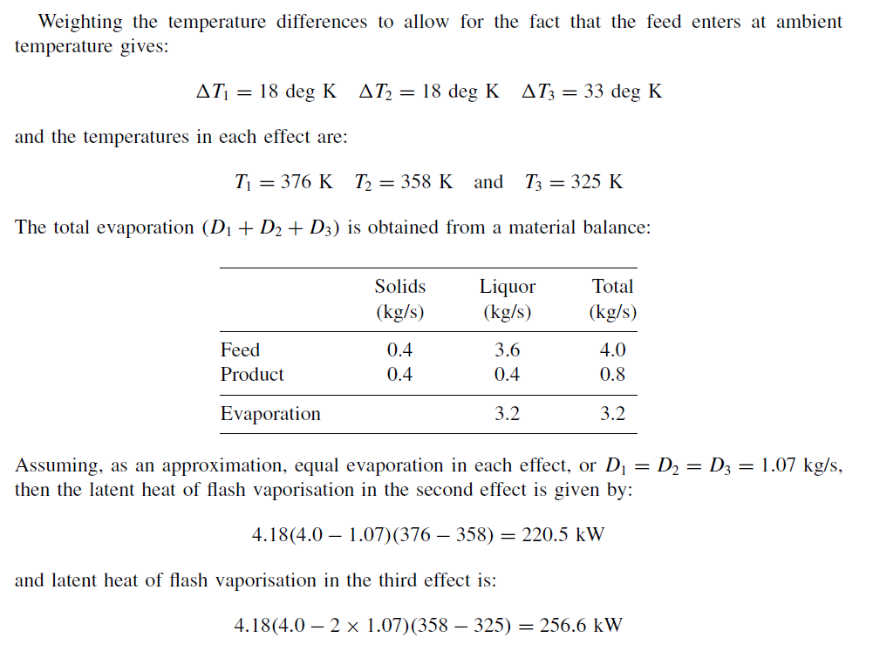

Slide 24
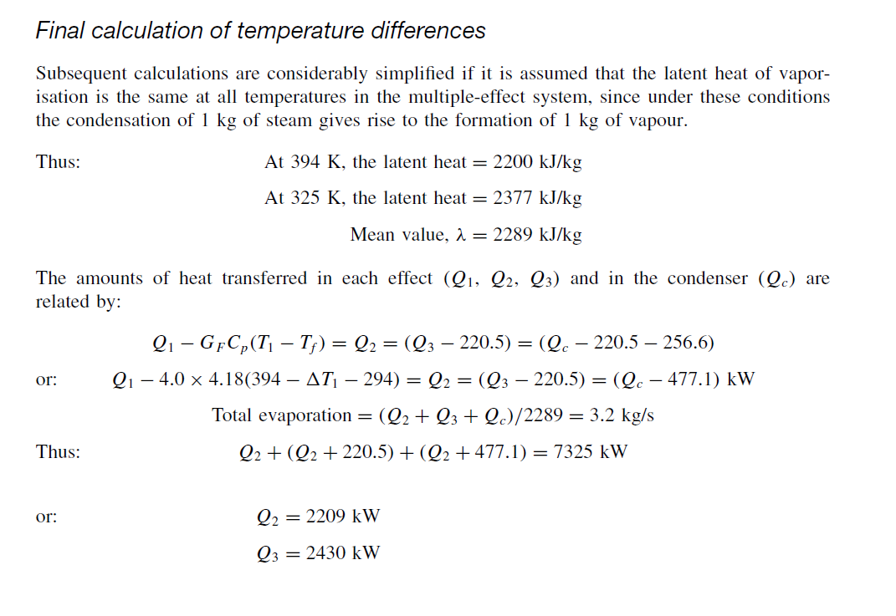

Slide 25
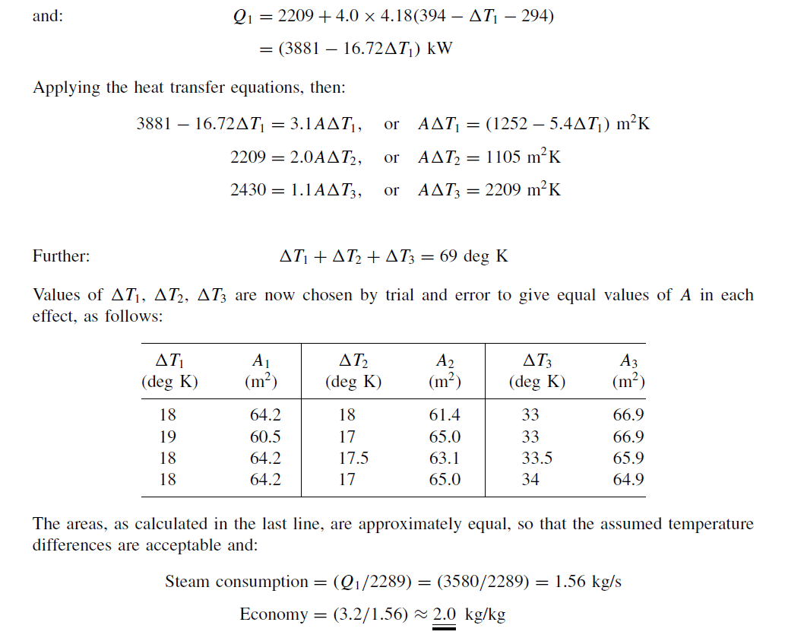

Slide 26
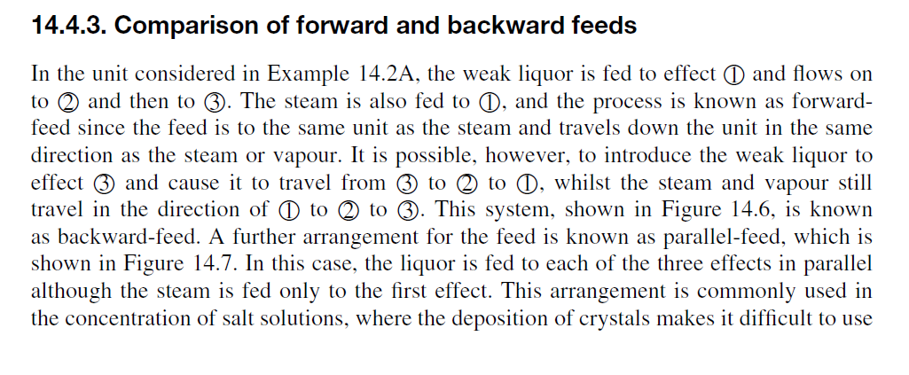
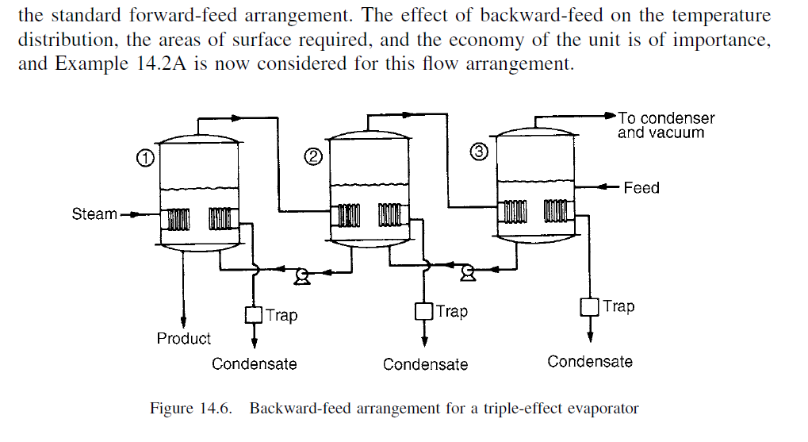

Slide 27
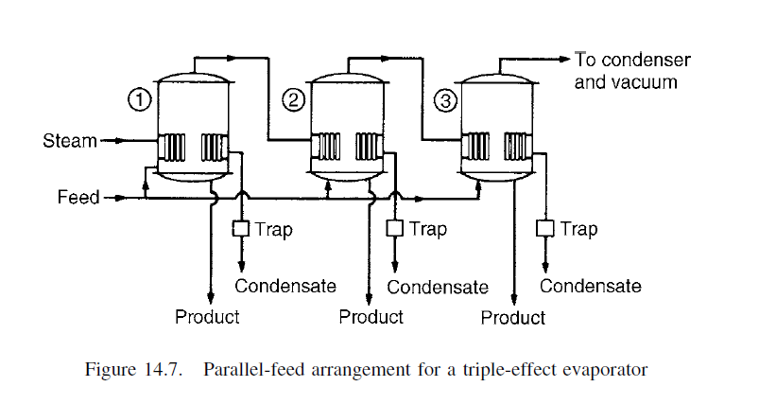

Slide 28
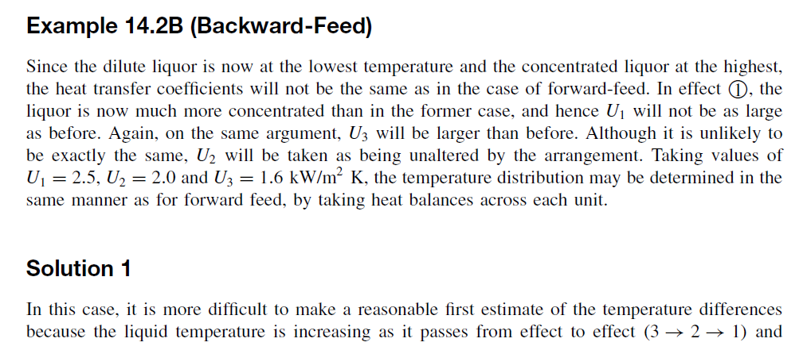

Slide 29
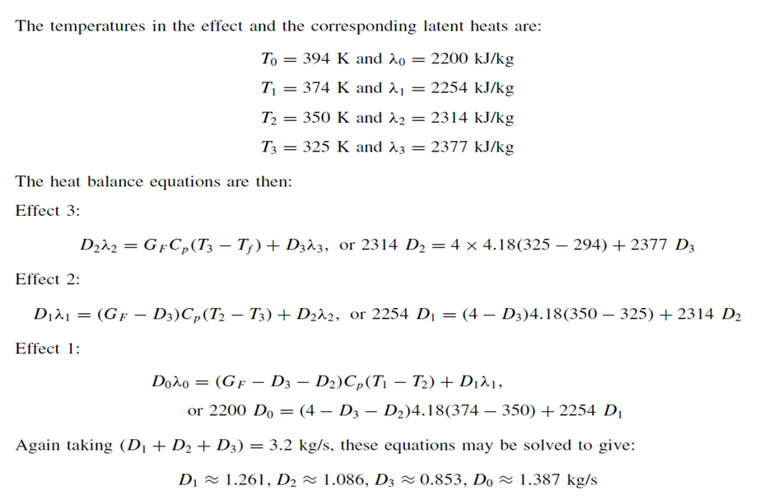

Slide 30
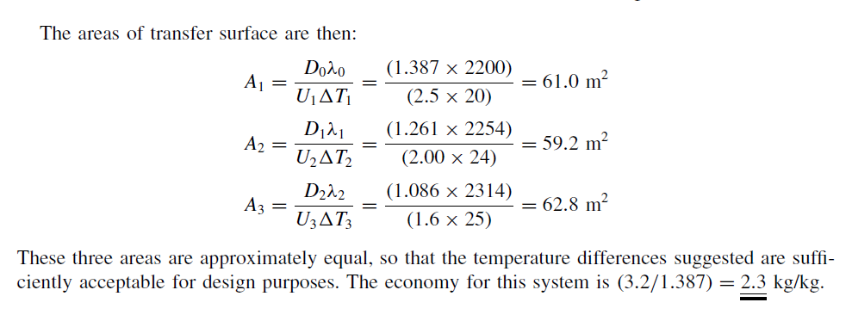

Slide 32
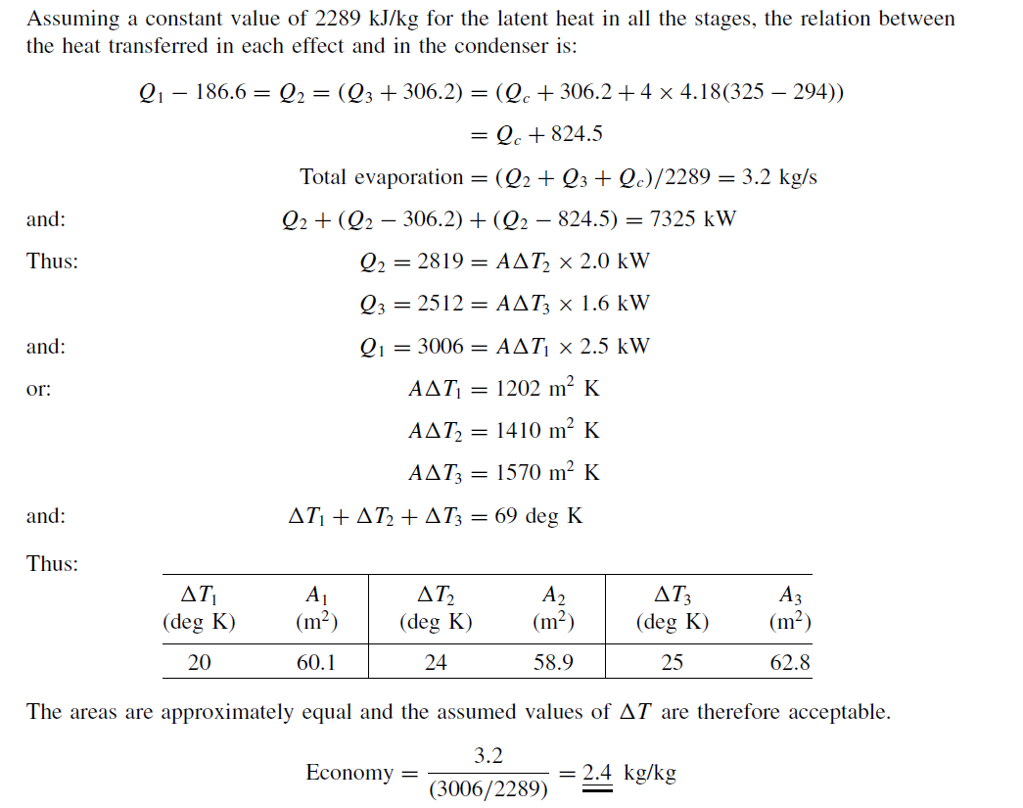

Slide 33
For the conditions of Example 14.2, the backward feed system shows a reduction in steam
consumption, an improved economy, a reduction in condenser load, and a small reduction in heat
transfer area.

Slide 34
